Slide 1

www.orchidproject.org
Notes:
Good morning, good afternoon, good evening - depending on where in the world you are joining us from! My name is Shannon Thomson and I am the Research Manager at Orchid Project. I will be presenting on the key findings from our Nigeria Country Profile update report which we are excited to be launching today. Thank you so much for being here and for your time today.

Slide 2
How was our report compiled?
What’s happening with FGM/C in Nigeria?
What does the data say?
What are the key drivers?
How do we move forward?
www.orchidproject.org
Notes:
My presentation will cover how our report was compiled, an overview of what is happening with FGM/C in Nigeria, what the data seems to be saying and what the key drivers of FGM/C practice are. We are honoured to have an amazing panel of guests with us today to go into more depth on a selection of key questions and to help map out the way forward.

Slide 3
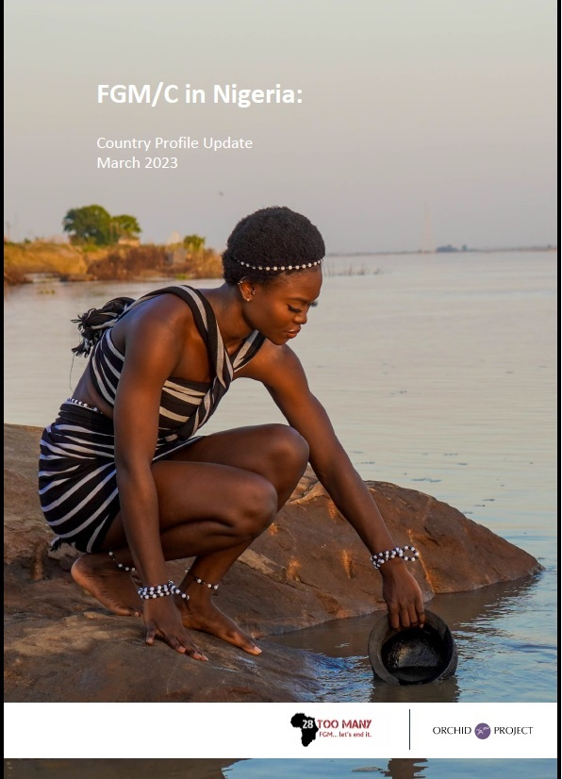
How was our report compiled?
Conducted comparative analysis of the data collected by DHS and MICS in Nigeria between 2013-2018
Literature review of both academic and grey literature
Key informant interviews with grassroots activists, community-based organisations and implementing iNGOs working to end FGM/C in Nigeria
Notes:
To start off, I will explain briefly how we compiled our report. This report is a country profile update which builds on the country profile report for Nigeria that was written in 2016. To compile this report, we reviewed academic and grey literature on FGM/C practice in Nigeria, political context, gender and social norms, and explored changes in national statistics and SDG targets. We had the opportunity to conduct interviews with grassroots activists, community-based organisations and implementing NGOs. We then went into further detail to analyse FGM/C trends by conducting comparative analysis of data collected by DHS and MICS in Nigeria between 2013-2018. (Data from the DHS surveys in 2003 and 2008 were not included in the analysis because of the variations in which types of FGM/C were included (Type 4 not included in 2003, Type 4 included by some research teams in 2008 (led to an increase in overall prevalence) and Type 4 included by all teams in 2013). This provided insight into changes over time in the practice and we will explore a few of those now.
For reference: DHS 2013, MICS 2016-17, DHS 2018

Slide 4
What’s happening with FGM/C in Nigeria?
The overall prevalence of FGM/C in Nigeria appears to be decreasing. In 2013, 24.8% of women aged 15–49 years had been cut, and in 2018 this figure was down to 19.5%.
Historically, FGM/C in Nigeria has been practiced among women and girls in higher wealth quintiles, with higher levels of education and in urban areas, a contrast to the trends in other parts of the world.
  However, this appears to be changing, with prevalence rates increasing in rural areas, among women and girls in the lowest wealth quintiles and with the lowest levels of education.
www.orchidproject.org
Notes:
Prevalence of FGM/C in Nigeria appears to be decreasing - from 24.8% in 2013 to 19.5% in 2018. Historically, Nigeria has followed a unique pattern with FGM/C prevalence in that it has mainly been practiced in urban areas, among the wealthiest quintiles and among those with the highest levels of education, which is the opposite of the trends in many other parts of the world. However, the most recent DHS data seems to show that this is changing. Prevalence seems to be decreasing among these groups and worryingly, seems to be increasing among women and girls in the lowest wealth quintiles, with the lowest levels of education and in rural areas. This shift is a key question that we will explore with our panel today.

Slide 5
What’s happening with FGM/C in Nigeria?
A worrying trend has emerged among girls aged 0–14 years.
  In 2013, 16.9% had been cut, but this increased to 19.2% in 2018
The population of Nigeria has almost doubled in the last 20 years, from 127m in 2002 to 215m
UNICEF estimates that 19.9 million Nigerian women and girls are survivors of FGM/C, which is the third-highest number of women and girls affected globally and represents about 10% of the global estimate.
www.orchidproject.org
Notes:
Although prevalence is decreasing among women aged 15-49, there is a worrying trend among girls aged 0-14. In 2013, 16.9% of girls 0-14 had been cut and in 2018, this had increased to 19.2%. When discussing FGM/C prevalence in Nigeria, it is critical to remember the population of the country. In 20 years, the population has almost doubled. UNICEF estimates that 19.9m Nigerian women and girls are survivors of FGM/C which is the third-highest globally and 10% of the estimate of women worldwide who have been cut.

Slide 6
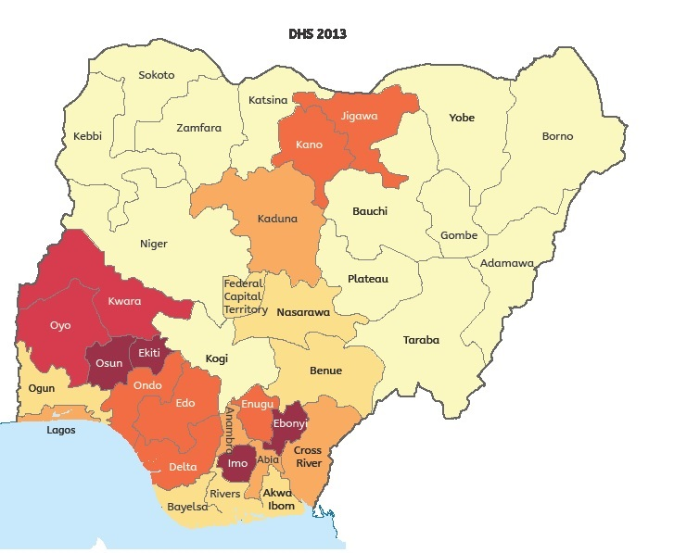
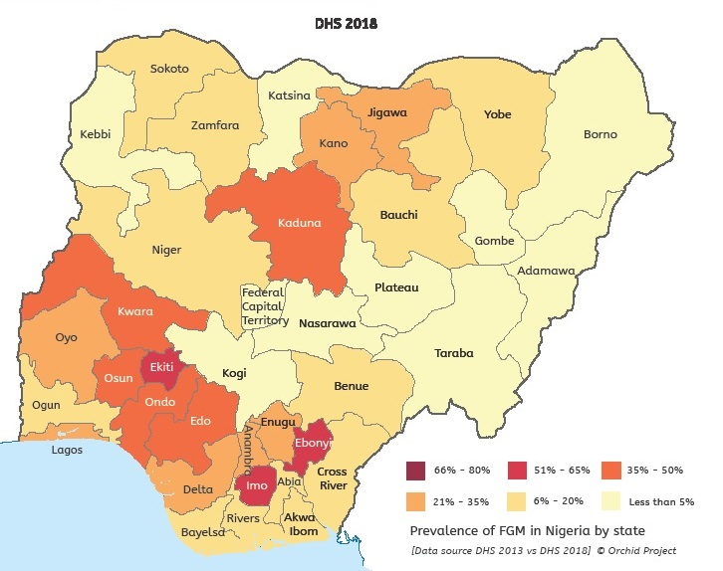
States in the Southern zones have historically had the highest prevalence. The regional distribution appears to be changing. With decreasing prevalence rates in Southern Zones and increased prevalence in Northern zones
www.orchidproject.org
Notes:
The map of prevalence within Nigeria shows distinct variations by region. These variations are heavily influenced by ethnic groups and where they live. Prevalence has historically been highest in the South South, South East and South West zones. Between DHS 2013 and 2018, there appears to be a shift in where the practice is occurring. A decrease in Southern zones and an apparent increase in Northern zones, particularly in Kaduna state.

Slide 7
What’s happening with FGM/C in Nigeria?
Programming has typically been targeted in high prevalence states in the Southern zones
However, when population sizes of each state are considered alongside prevalence rates, the priority states change from those with the highest prevalence by percentages (Imo, Ekiti, Ebonyi, Kaduna, Kwara and Osun) to those with the highest actual number of girls affected (Lagos, Kaduna, Imo, Kano and Oyo).
Using prevalence rates together with population data presents a different approach to targeting FGM/C programming in Nigeria, focusing where the largest number of girls are at risk.
www.orchidproject.org
Notes:
Prevalence rates have historically been used in Nigeria to target programming, which has meant that programming has been focused in Oyo, Osun, Ekiti, Imo and Ebonyi states, although programming has been done in other areas. However, when population data is used together with prevalence rates, different states emerge as priorities. The highest actual number of girls affected or at risk are in Lagos, Kaduna, Imo, Kano and Oyo.

Slide 8
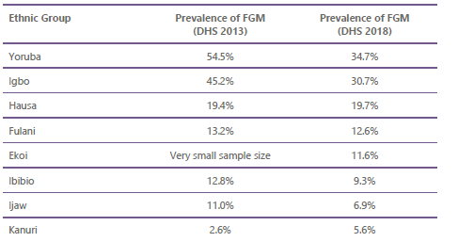
What does the data say?
Ethnicity plays a major role in the prevalence of FGM/C and cultural identity is a key driver in its continuation.
www.orchidproject.org
Notes:
When we look at drivers of FGM/C in Nigeria, ethnicity plays a major role. Of all motivations for undergoing FGM/C, social acceptance and identity are the highest reported drivers. We can see from the table here that the main ethnic groups practicing FGM/C in Nigeria are Yoruba, Igbo, Hausa and Fulani, with some prevalence among other groups.

Slide 9
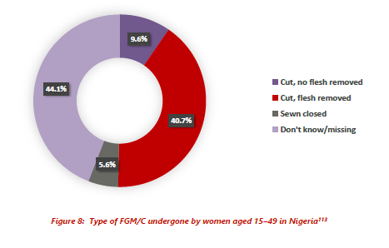
What does the data say?
www.orchidproject.org
Notes:
9.6% of women and girls report being cut, no flesh removed and 40.7% report being cut, flesh removed. However, 44.1% do not know what type of cut they have had.
There are three types of FGM/C that are unique to Nigeria, which include angurya and gishiri and the use of corrosive substances. Angurya involves excision of the hymen, which is thought to be too thick. Angurya can also include scraping of the vaginal tissue. This type of cutting is most often performed on very young children/babies.
Gishiri involves an incision of the posterior or anterior vaginal wall. This cut is also based on a mistaken belief that the vagina is too small and so will cause difficulty for a woman at first intercourse and during childbirth.

Slide 10
What does the data say?
In the DHS 2018, women aged 15–49 who had undergone FGM/C were asked if they experienced any of the distinctive types of cutting.
  40.4% experienced angurya
  13.0% experienced gishiri
  6.6% underwent the application of corrosive substances.
The data indicate a substantial increase in angurya cuts, from 24.9% in 2013 to 40.4% in 2018.
www.orchidproject.org
Notes:
There appears to be a significant increase in angurya cutting between 2013 and 2018. This may be the result of how FGM/C is understood and influenced by awareness campaigns or could represent an actual shift toward this type of cutting. Of all women in Nigeria who have experienced FGM/C, 40.4% report undergoing angurya cuts. This increased from 24.9% in 2013.

Slide 11
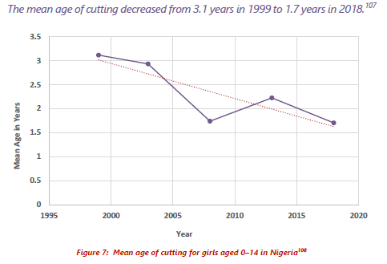
What does the data say?
www.orchidproject.org
Notes:
The average age of cutting in Nigeria is young but it is getting younger over time. Looking back at data from 1999 to 2018, the mean age of cutting has gone down from 3.1 years to 1.7 years.

Slide 12
What are the key drivers?
Key drivers
Cultural identity and belonging
Social obligation as a driver of FGM/C in Nigeria outweighs drivers linked to religion, purity/chastity or hygiene.
Mothers, mothers-in-law and grandmothers are key protectors of the tradition and impose social pressure on women to have their daughters cut.
The age of cutting in Nigeria is very young and getting younger.
Historically, Nigeria has followed the opposite trend to other countries where FGM/C is practised. Cutting has primarily been practised by those in the highest wealth quintiles, those with the most education and those who identify as Christian. However, this appears to be starting to change.
www.orchidproject.org
Notes:
In a 2013 report, UNICEF emphasised the problem of a ‘culture of silence’ in Nigeria, in which there is a significant gap between people’s personal views on FGM/C and their feelings of social obligation to have girls undergo the cut. Mothers, MILs and grandmothers are protectors of the practice and put social pressure on women to have their daughters cut, this is often reinforced by TBAs and in some areas, linked with traditional naming ceremonies. The age of cutting is very young and getting younger over time, which reinforces the understanding of the link between cutting and cultural or ethnic identity and belonging.
The dynamics of cutting are changing however. Nigeria used to follow an opposite trend to most other countries where FGM/C is practiced as prevalence was highest among wealthiest quintiles, those with the highest levels of education and in urban areas. This appears to be shifting - toward rural areas, women and girls in lower wealth quintiles and with lower levels of education, also increasing prevalence among Muslim communities. Is this a true shift or the result of social desirability bias among groups who have had more exposure to awareness-raising and prevention efforts?

Slide 13
How do we move forward?
Looking at the shift from urban to rural areas, is this a true shift or is this partly explained by social desirability bias among urban, educated and wealthy populations?
What is driving the change in geographic prevalence from Southern zones to Northern zones?
How do we understand and explain the changes in Type 4 cutting (angurya, gishiri and use of corrosive substances)?
Notes:
These questions will frame our discussion with our panelists today. We hope to be able to understand what appears to be changes in the practice of FGM/C in Nigeria and will explore the perspectives of those working at the grassroots and in regional and national advocacy to understand these changes. We will first explore the change in the dynamics of cutting - from urban to rural areas and among the wealthiest and most educated to the least. We will then discuss the changes in geographic prevalence from Southern to Northen Zones, and finally we will seek to understand more about Type 4 cutting in Nigeria and that apparent increase in these types of FGM/C. This will help us to map out the way forward for continuing to work toward eradication of FGM/C in Nigeria. Please be reminded that after the panel discussion, we will have a Q+A session, so please input your questions into the Q+A box as they arise. Thank you so much for your attention to this presentation. I will now hand back to Kim who will lead us into the panel discussion.

Slide 14



